Slide 1
CSE1ICB – Introduction to Cybersecurity
Lecture 5: Data Security
Dr Naveen Chilamkurti
Computer Science & Information Technology
November 2017

Slide 2
The nature of data
Data is the digital representation of raw information
    Created using information technology
    Consumed by information technology

Slide 3
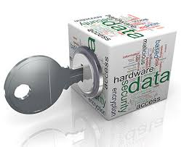
The role of data
Control of data is critical to business:
    Businesses use data to make decisions
    Businesses use data to derive value
Data is interpreted into business information
    Information drives innovation and change
    Information allows operational refinement
    Information underpins competitiveness
Data is therefore a core business asset
Control of business data is core to information security

Slide 4
Data leads to actionable insight
Wisdom
Knowledge
Information
Data
Evaluated understanding
Information in context
Knowledge with insight
Understanding & meaning
Data processed to be useful
Data with meaning
Discrete facts
Raw symbols

Slide 5
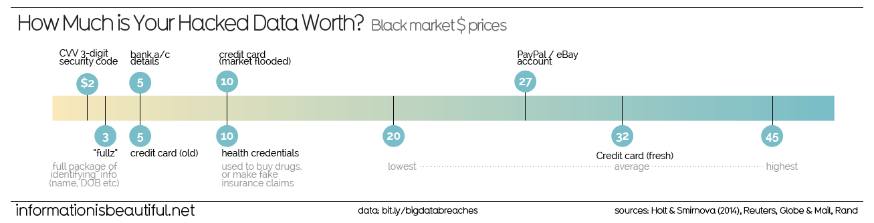
The information economy
Data and information have inherent value, making them a target for cyber criminals
There is a thriving black market for stolen data, both business and personal

Slide 6
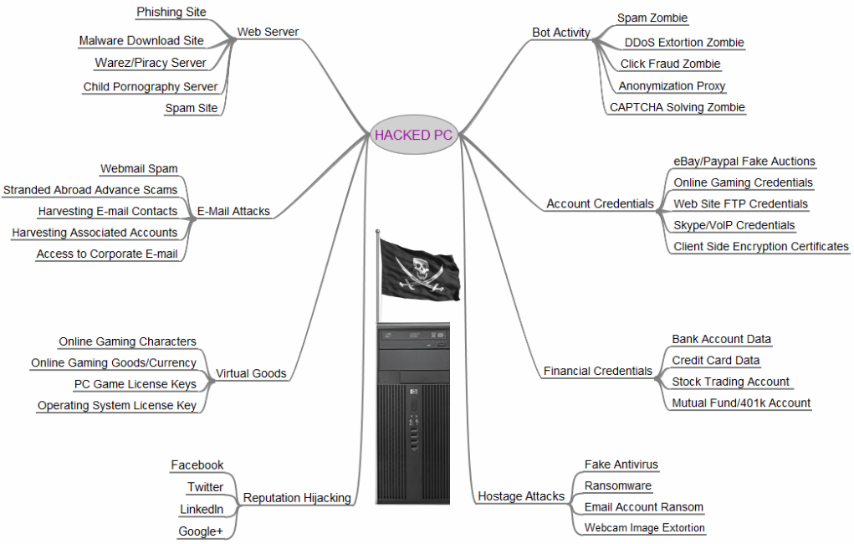
What data do I have that is valuable?

Slide 7
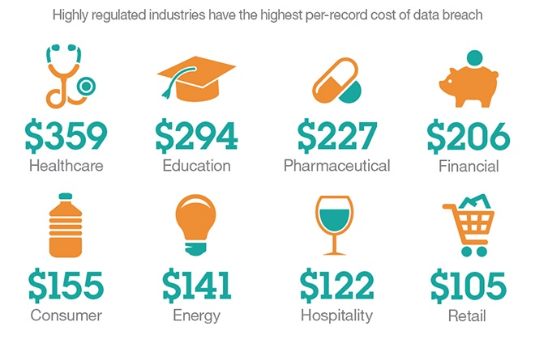
Cost of a data breach
In 2017 the affected cost of Australian companies affected by a data breach was $2.51 million*
(* https://www-03.ibm.com/security/au/en/data-breach/)

Slide 8

The economics of data
“Big data” is a growth industry
    Massive aggregation of data from many sources
    Generate insights to predict spending
    Drives modern marketing and advertising
Analytics and data brokers abound
    Aggregate and analyse big data
    Resell these insights to support targeted advertising
Creates an increased aggregation exposure…
    Equifax breach of 2017
    140M sensitive personal records from a credit checking bureau

Slide 9
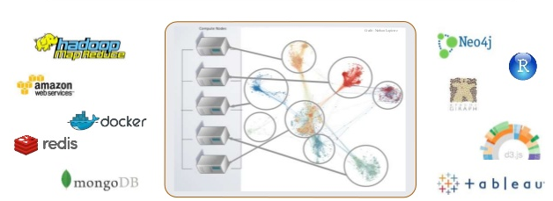
The rise of social media
Social media platforms create a useful social service to collect and analyse social data
You are the product, not the customer!
Social media analytics drives mature purpose-built platforms

Slide 10
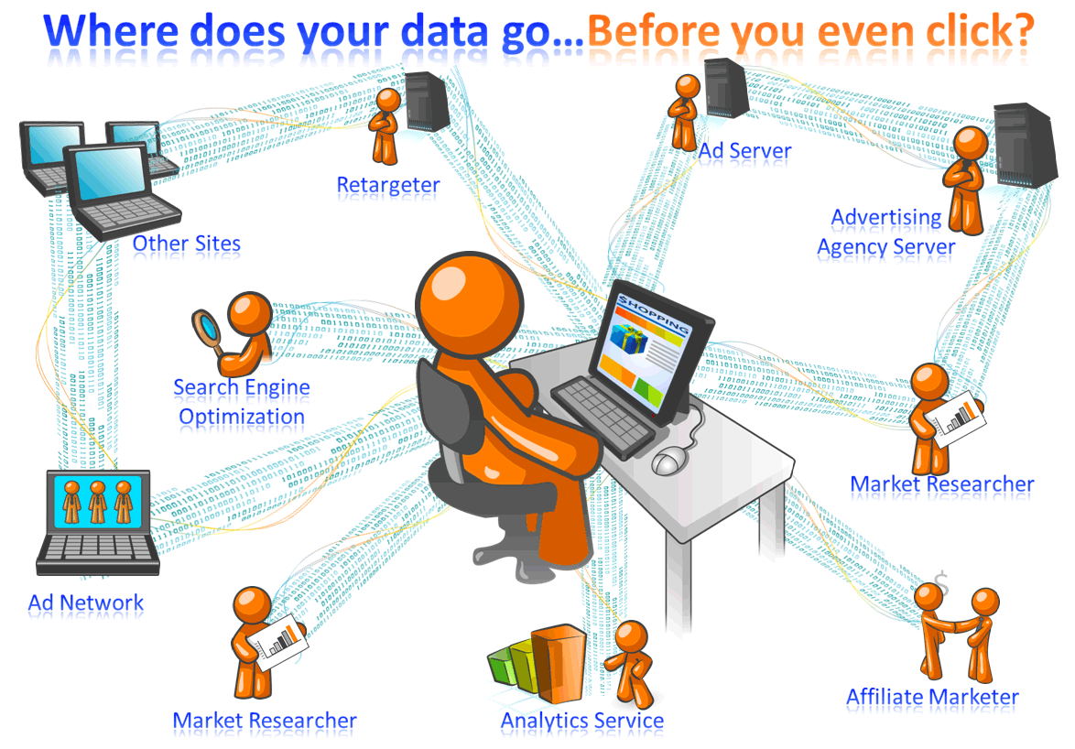
So much for privacy!

Slide 11
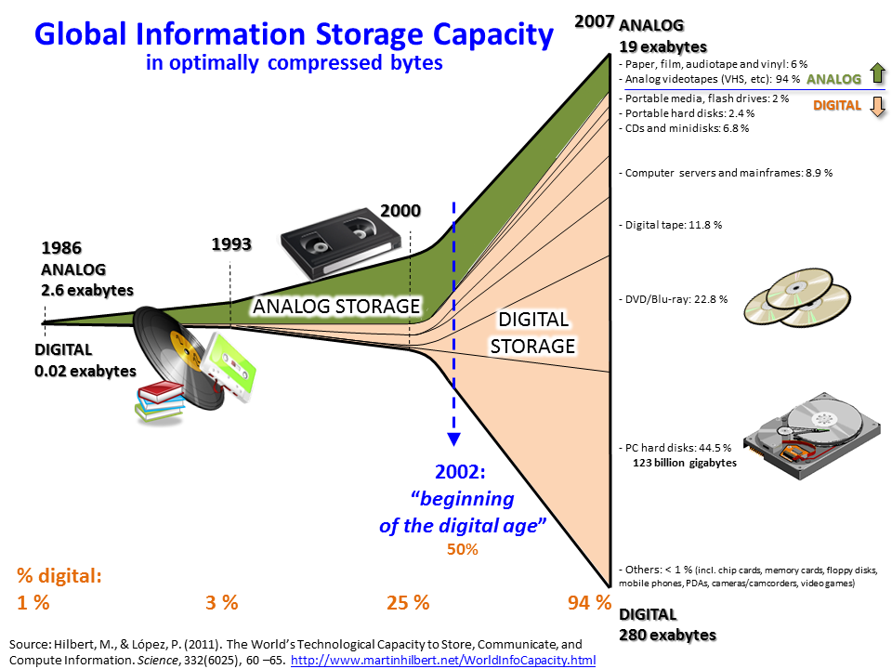
How much data?

Slide 12
Big Data
“Everyday, 2.5 quintillion bytes of data are created and 90% of the data in the world today was created within the past two years”.
IBM Corporation
“Worldwide information is more than doubling every two years, with 1.8 zettabytes or 1.8 trillion gigabytes projected to be created and replicated this year alone”.
ZDNet news
…
10¹⁵ = quadrillion (petabytes)
10¹⁸ = quintillion (exabytes)
10²¹ = sextillion (zettabytes)

Slide 13
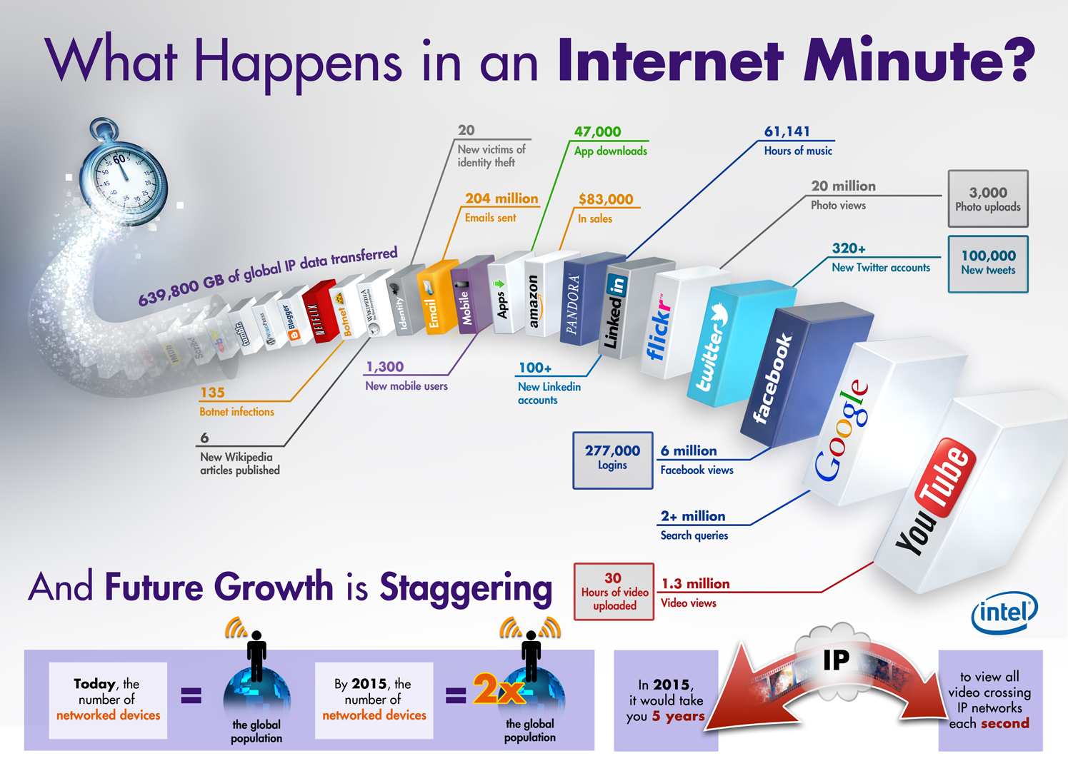
http://archive.tiecon.org/content/big-data-landscape-why-should-you-care

Slide 14
Role of information in business
Data and information play a critical part in every business
Customer Information
This is your revenue base – the information about current and future sales prospects
Transactional Information
This is the real-time picture of what your business is processing or achieving
Historical Information
Transactions from prior periods, used to derive trends and patterns that underpin future decisions

Slide 15

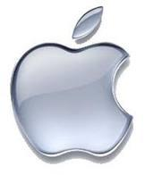

The role of information in business
Some business information assets are created specifically to support or identify the business
  Image and branding – uniquely identifying a business or entity and providing an instant emotional link for customers
Trademark | A recognisable sign, design or expression Identifies and distinguishes products or services of a particular source from another In most jurisdictions a trademark must be registered with a local intellectual property body

Slide 16
The role of information in business
  Intellectual property – ideas, inventions or formulas that allow a business to generate revenue
Trade secret | A formula, practice or process used by a business for their economic advantage Not generally known or discoverable by others Not registered, must be protected by the owners Often the target of industrial espionage
Patent | Rights assigned by a government department Allows an inventor to exclusively benefit from an invention Patent must be registered and made public
Copyright | Legal right of the creator of a creative work Allows exclusive use for a limited time May apply automatically on creation, but may require registration in some jurisdictions

Slide 17
The importance of trust
Consumer confidence underpins the economy
    Share prices and indices reflect the ‘strength’ of a marketplace
    Prices fluctuate if investors’ confidence in the company wavers…
Business and government are custodians of large data sets
    Governments generally hold rich data sets about all citizens
    Traditional large enterprises like banks and insurance companies
    Recent information-based businesses like social media platforms…
With great power comes great responsibility…
    Loss of these data can seriously affect consumers’ trust in a business

Slide 18
The betrayal of trust
Concentration of information creates a compelling attack surface
    This is known as an “aggregation threat”
Cloud computing brings this into sharp focus
    Many companies use a small number of cloud providers
    Many tenants = lots of data to be compromised
    Remoteness and abstraction may mean loss of control by the data owner…
Adequate protection of these data is:
    An assumed right by these companies’ customers and the general public
    A legal right in many jurisdictions

Slide 19
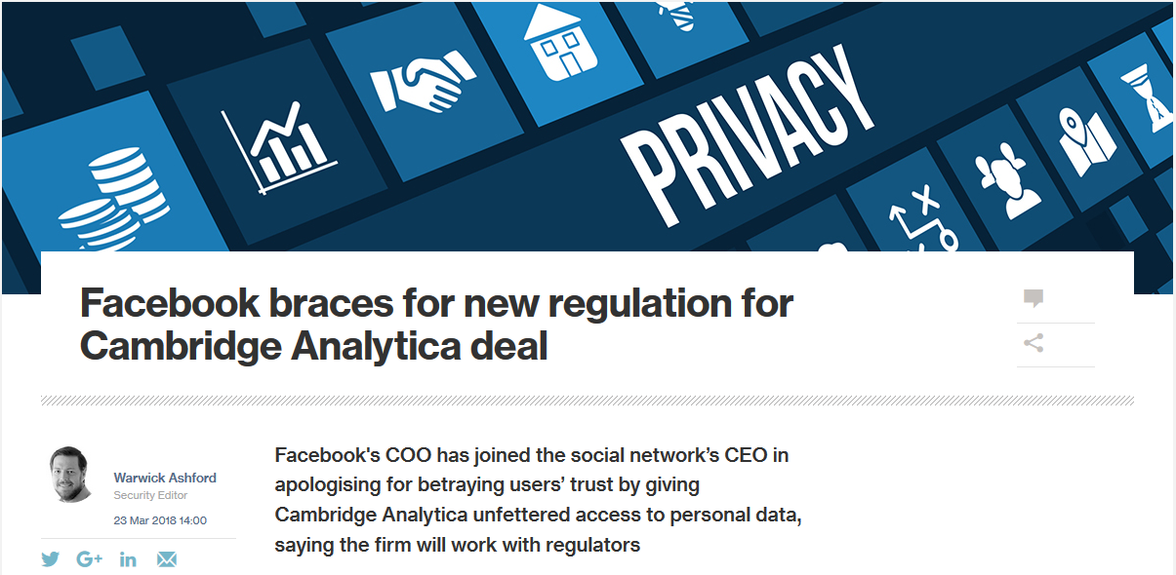
Case study: Facebook
  In March 2018, it was revealed that Facebook allowed the firm Cambridge Analytica access to the profiles of 50M users without their express consent

Slide 20

Case study: Facebook
So we know that Facebook is primarily a data brokerage…
    It maintains extensive data sets on an estimated 2.2 BILLION people
    That’s around 30% of the world’s population…!
Weak privacy constraints in the terms of service
    Allowed information of all friends’ of consenting users to be gathered
    Has been internally flagged by Facebook for investigation since 2015
Revelation has caused a massive “delete Facebook” movement
Facebook shares have tumbled
    Lost 7% value in one day, wiping
    $36 Billion from the stock price…

Slide 21
The regulation of data in Australia
The Privacy Act (1988) contains the Australian Privacy Principles (APPs)
    Outline handling of personal information for any “APP entity”
    APP entity = > $3 million in annual turnover
The Office of the Australian Information Commissioner (OAIC) provides information about the act and the principles
https://www.oaic.gov.au/privacy-law/privacy-act/australian-privacy-principles
In 2017 the Notifiable Data Breaches amendment was passed
    Regulated entities must notify any victims of a data breach
    There must be an expectation of serious harm resulting from the breach

Slide 22
Australian Privacy Principles
The APPs apply to all sensitive information
Health information (including genetic information)
Racial or ethnic origin
Sexual orientation or practices
Political opinions and association memberships
Religious and philosophical beliefs or affiliations
Criminal record
Biometric information

Slide 23
Australian Privacy Principles
APP 1 | Manage information in an open and transparent way (privacy policy)
APP 2 | Individuals should have the right to anonymity or pseudonymity*
APP 3 | Defines circumstances under which personal information (PI) may be obtained
APP 4 | Defines how entities must deal with unsolicited PI
APP 5 | When must an entity notify an individual who’s information they hold?
APP 6 | Defines the circumstances under which an entity can use or disclose PI
APP 7 | Conditions under which PI can be used for direct marketing
APP 8 | Handling of PI before it is disclosed overseas
APP 9 | Handling of government identifiers (such as TFNs)
APP 10 | An entity must ensure the accuracy of the PI it holds
APP 11 | Defines the secure handling, storage and destruction of the PI
APP 12 | Defines access rights of an individual to their own PI
APP 13 | Obligations of an entity in relation to correcting PI it holds
Notes:
* Limited exceptions apply

Slide 24
International regulation
General Data Protection Regulation (GDPR)
European Union
Comes into force in May 2018, replacing the 1995 Data Protection Directive
Personal Information Protection and Electronic Documents Act (PIPEDA)
Canada
Very similar to Australia’s Privacy Act
Mandates the existence of information protection controls for federal agencies
Federal Information Security Management Act (FISMA)
USA
Governs the export of personal information outside the EU
Added a mandatory breach notification amendment in 2015
Covers private sector organisations
Closely aligned with NIST standards, guidelines and methods for securing data

Slide 25
Industry regulation
Australian Prudential Regulation Authority (APRA)
Health Insurance Portability & Accountability Act (HIPAA)
Payment Card Industry Data Security Standard (PCI-DSS)
Regulates all Australian deposit-taking institutions (e.g. banks)
Maintains various prudential standards and advisories to ensure data security
Enacted in the USA in 1996
Title II of the act covers privacy and security of health information
Created in 2004 by the combination of five major card scheme programmes
Twelve separate requirements for compliance

Slide 26
States of data
Digital data and information can exist in several discrete states
Security threats and controls will vary in each case
Stored
In transit

Slide 27
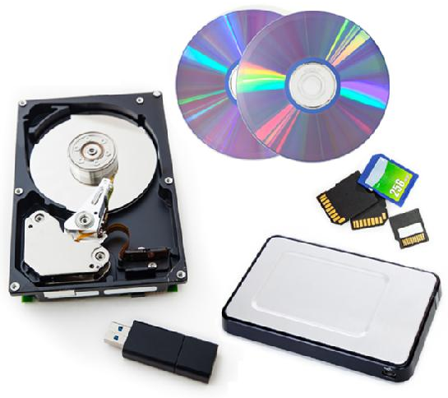
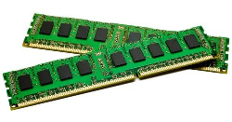
States of data
Stored Data
  The information is imprinted onto a storage medium (flash memory, magnetic disk, etc.), and is further described by its lifespan:
    Persistent stored data: information
    is retained for a longer time, usually
    between system restarts (e.g. a file
    system on a local or removable disk,
    a network shared drive, a database)
    Transient stored data: information is
    short-lived and may not survive a loss
    of power (e.g. temporary cache, volatile
    memory)
  Security may be provided by disk encryption, file encryption or access control

Slide 28
States of data
Data In Transit
  The information is represented as a modulated signal on a transport medium as it travels between two nodes or hosts
    Electrical signal (copper Ethernet or serial cables)
    Light pulses (optic fibre cable)
    Microwave radiation (radio frequency signal)
  Security is provided by:
    Transport encryption
    Secure network cabling
    Private network circuits

Slide 29
Types of data
Unstructured
Structured
Controlled by many users
Low management overhead
Poor metadata
Hard to search
Examples are file systems and web pages (e.g. Google)
Requires validation when being created or updated
Usually a single channel/method of access
Indexed for efficient searching
Examples are relational databases

Slide 30
Types of data
Different data types present different security challenges
  Structured data
    Access is strictly controlled via a known channel / program
    Structure is checked and validated and illegal data dropped
    Less flexible but simpler to control and therefore secure
  Unstructured data
    Access may occur via many different channels or programs
    Structure and content vary depending on file type
    Many different users and processes must be monitored
    Very flexible but very difficult to effectively secure

Slide 31

Case study: Google Search
The World Wide Web is a large and partially structured data set
    HTML and other files follow a known standard structure
    Page content may be created by any user or any process
Google continually crawls the entire visible web, and indexes what it finds
    When a search query is run, Google looks up
    its index to rapidly find the answer it needs
The reason Google works so well:
    It parses a huge body of partially structured data (web pages and files)
    It converts these into a structured data set (the Google index)

Slide 32

Case study: Google Search

Slide 33
Case study: Google Search
So what has this got to do with security?
    An interesting side-effect of this process is that every file that is accessible from the WWW is indexed by Google
    If Google can see it, we can find it..!
Google has advanced search capabilities, that let you uncover things that probably shouldn’t be available to the public…

Slide 34

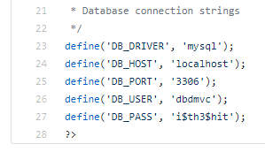
Case study: Google Search
Be careful what you publish to the World Wide Web, because Google will find it!

Slide 35
Physical data storage
Data may be housed in several different physical media types
Paper
Magnetic
Optical
Semiconductor
Documents
Books
Traditional filing systems
Tape
Floppy disks
Hard disks
Compact disk (780nm)
Digital Versatile Disk (650nm)
Blu-ray (405nm)
Volatile (capacitor-based RAM)
Non-volatile (NAND flash, EPROM)

Slide 36
Physical data storage security
Different physical media have different security challenges
  Paper media
    Physical security is paramount
  Magnetic and optical media
    Portable media requires physical security to be considered
    Data at rest can be scrambled or encrypted
  Volatile RAM
    Secure as long as the system it is inside is kept secure
  Non-volatile flash and EPROM
    Physical security and encryption concerns, much like removable disks

Slide 37
Logical data storage
When data is written to a digital medium there are several key concepts that become important:
  Blocks
    Most disks store data in streams of bits known as blocks. Block architecture is dependent on the medium used and the protocol(s) used to access it.
  Files
    A storage medium presents its blocks to the operating system as a hierarchal file system. A File Allocation Table (FAT) tells the OS which blocks make up each file.
  Objects
    Large collections of data may be further abstracted from the hierarchal file system via an object database.

Slide 38
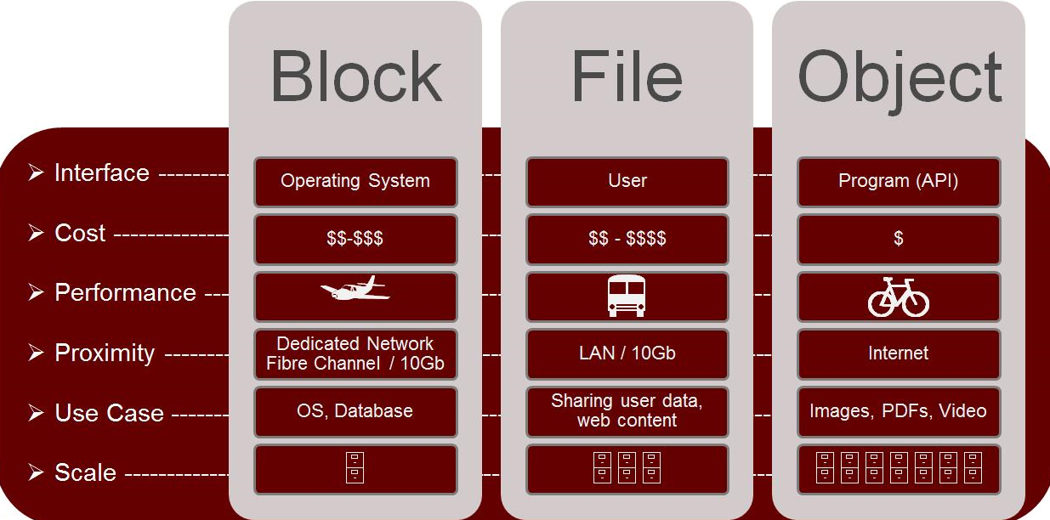
Logical data storage

Slide 39
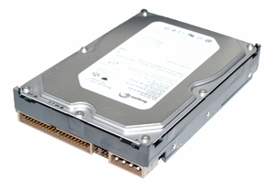
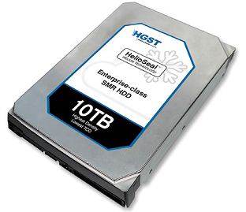
Storage technology security
Magnetic disk capacity has massively increased in recent years
This requires an incredible density of bits on the same size platters
    Accurate storage therefore requires
    constant error correction
    The disk must have a supply of spare
    sectors to ‘swap in’ to service when others
    fail
Sensitive data may be ‘swapped out’
on a faulty sector
    Can be recovered later using a forensic
    process
10GB hard disk in a 3.5” housing
1994
2017
10TB hard disk – same physical size and 1000 times more storage

Slide 40
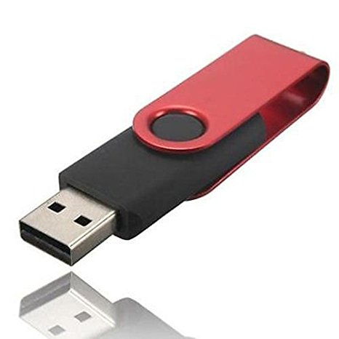
Storage technology security
NAND flash storage has a finite lifespan, due to the electrical process used to read and write bits
    Modern flash has ~100,000 ‘write cycles’ before it deteriorates
To counter this, flash devices use a technology called wear levelling to spread the writes across all NAND cells
    The active cells used to store data change constantly
Like swapped sectors, cells not currently
in use may still contain sensitive data
    Be careful when disposing of flash media!

Slide 41
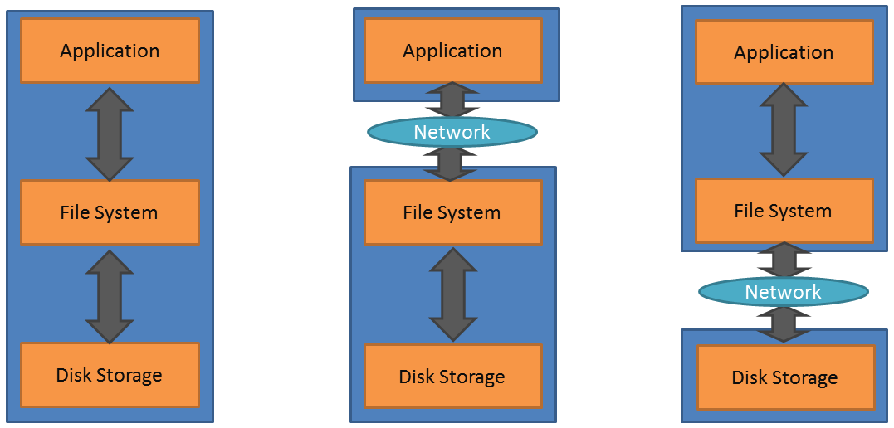
Storage paradigms
Fixed storage media may follow several architectural paradigms
Direct attached storage
(DAS)
Network attached storage
(NAS)
Storage area network
(SAN)

Slide 42
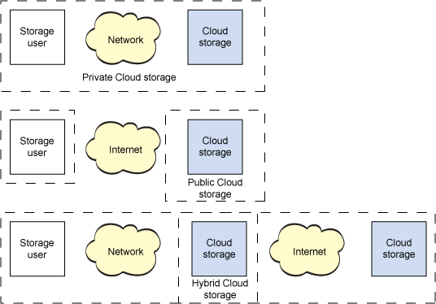
Storage paradigms
Cloud storage is becoming more common, and this introduces new architectures that have unique security challenges
    Cloud storage access is often
    via the public Internet
    With traditional on-premises
    network storage (SAN/NAS)
    the local private network
    carries the data
    All the threats pertinent to
    the Internet must now be
    considered when using
    public or hybrid cloud-based
    storage
Notes:
I don’t like this diagram, need to redraw it…

Slide 43
Data transport
Access to data by the operating system can occur using a variety of protocols
Paradigm | Description | Protocols
Local storage | Storage medium is directly attached to the machine running the operating system and/or application | IDE SCSI SATA
Data network | Storage medium is located near the application, and is accessible via a local private data network (LAN) | SMB NFS
Storage network | Storage medium is located near the application, and is accessible via a local private storage network (SAN) | FCP iSCSI
Remote network | Storage is housed remotely to the application, such as a cloud storage provider or any web server visible on the public Internet | HTTP FTP SFTP

Slide 44

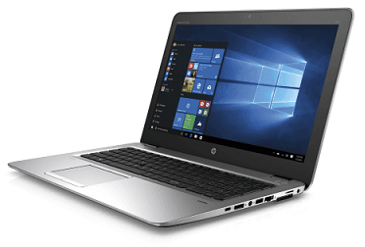
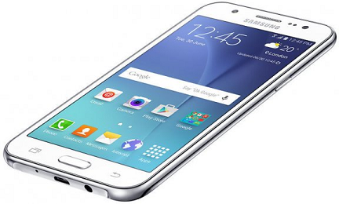
Portable storage security
Information is more portable than ever…
These devices contain our digital lives
    Personal information such as banking details
    Passwords to our WiFi networks, shopping websites etc.
You must understand what data is stored on portable devices and how it is protected if the device is lost or stolen

Slide 45
Data lifecycle
Data, and the information derived from it, exist in a complete lifecycle
Several key roles exist
within this cycle:
  Data owner
    Creates the data and makes
    key decisions
  Data custodian
    Manages the data on behalf of
    the data owner
  Data consumer
Data management
Data destruction
Data creation
Data consumption

Slide 46
Data owner
The data owner is ultimately accountable for the safety of the data
    The owner usually creates the data, or is responsible for its gathering or inception
    The owner derives business value from the data
    The owner suffers business impact from mishandling of the data…
Therefore, all critical decisions regarding the data must be made by the owner
    Data handling decisions (some may be delegated to the custodian)
    Data risk decisions – evaluating the impact of any harm to the data, and deciding how to treat any risks to which the data is exposed

Slide 47
Data maintenance
Following creation, control of the data must be maintained throughout its lifecycle
This is the role of the data custodian
    The data owner delegates some control to the custodian
    This may manifest as approval of access requests, based on defined criteria
The custodian manages the following aspects of the data
    Access to the data (mitigating any confidentiality threat)
    Changes to the data (mitigating any integrity threat)
    Deletion of the data (mitigating any availability threat)

Slide 48
Data consumption
During its lifecycle data will be consumed by various parties in the process of doing business
Good data management requires tracking and auditing of the use of these data, to detect unauthorised events
    Access control logs – recording when individual data objects were accessed, and by whom
    Change logs – recording what changes occurred during the access events recorded above
    Integrity monitoring – ensuring that changes to data only occur during expected events any by authorised parties
    Non-repudiation – ensuring that changes to the data cannot be denied by the party who made them

Slide 49
Data protection
To protect data during its consumption, we must also prevent unauthorised changes or access
  Confidentiality
    Ensure the secrecy of stored and transmitted data using encryption, thus ensuring that only the authorised parties can read the information
  Integrity
    Ensure that change occurs only via prior approval, and all changes are validated where possible to prevent corruption or tampering
  Availability
    Authenticate all access requests and all events (read, write, change, delete) to prevent data being removed or scrambled by an unauthorised party

